Slide 1




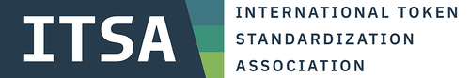
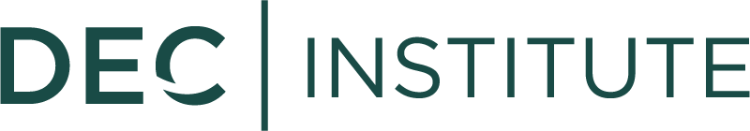



Session 3
ORGANIZED BY
Follow us on
February 21, 2024
Supported by

Slide 2
Agenda for today
@Mentors: “Mentor - Name”
Please mute yourselves
Agenda | Min.
Stay informed / organization | 7
Tip of the week | 1
Attendance | 2
Breakout: Assignment presentations | 25
Reflection in the main room | 20
Assignment & outlook for next session | 5
Guest Speaker | 30

Slide 3




Web3 Talents at #CAC24A
On-Site: SAVE 40%* - Code: CAC24_Talents
Streaming: SAVE 100% - Code: Assets 24 Talents
Join fellow Web3 Talents at Frankfurt School Blockchain Center’s Crypto Assets Conference 2024A (#CAC24A) on April 16 on site at Frankfurt School of Finance and Management or online!
Perfect networking opportunities
Covering the latest trends in the industry
Participation on-site or streaming online
CAC24A
Tuesday, April 16th, 2024
Digital Assets
The world of digital assets and its potential in present and future
Digital Securities
Digital bonds, digital funds, digital shares, DLT Pilot Regime, eWpG
Tokenization of Assets
MiCA regulation, real estate, music rights, luxury goods, vintage cars
Bitcoin, Web3 & Tokens
The disruptive potential of the decentralized world
*Save 40% on original full-priced ticket. This discount is only valid for current and recently completed Web3 Talents as of February 2024 in the DLT Talents, DeFi Talents, NFT Talents, Bitcoin Talents and ReFi Talents cohorts. Any tickets purchased by individuals not enrolled in a Web3 Talents program will not be valid.

Slide 4
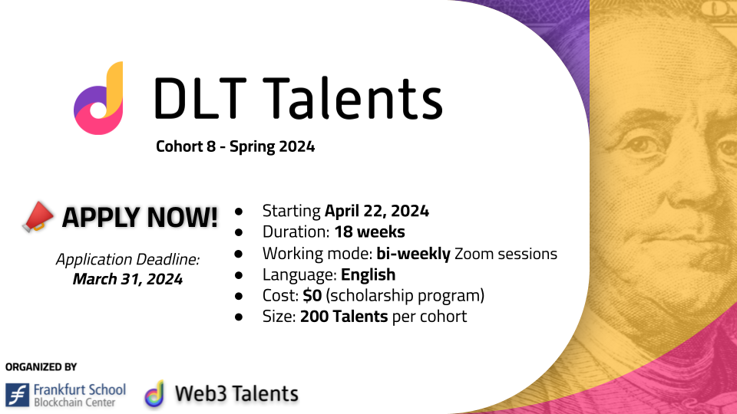

Slide 5

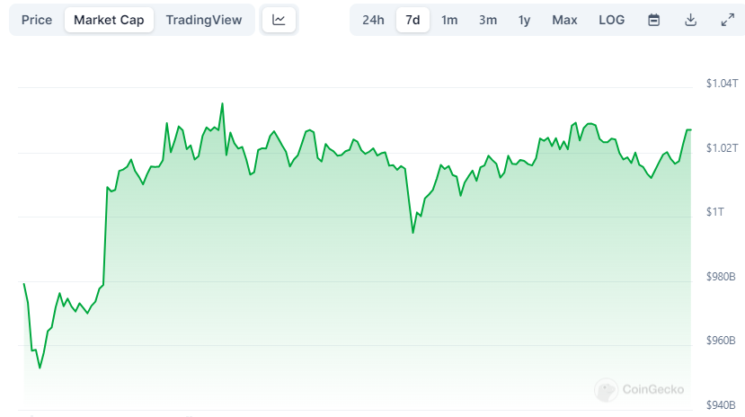
Stay informed
@Mentors: “Mentor - Name”
Bitcoin surpassed $50.000!
“Crypto landscape report in Latin America” by Bitso
Bitcoin is the favorite cryptocurrency in Mexico and Brazil (Real is stable currency)
USDT is the favorite crypto in Argentina and Colombia (Argentina has highest inflation)
Women start investing later in crypto but Bitcoin is their preferred asset
Market capitalization of Bitcoin is $1.02 trillion

Slide 6
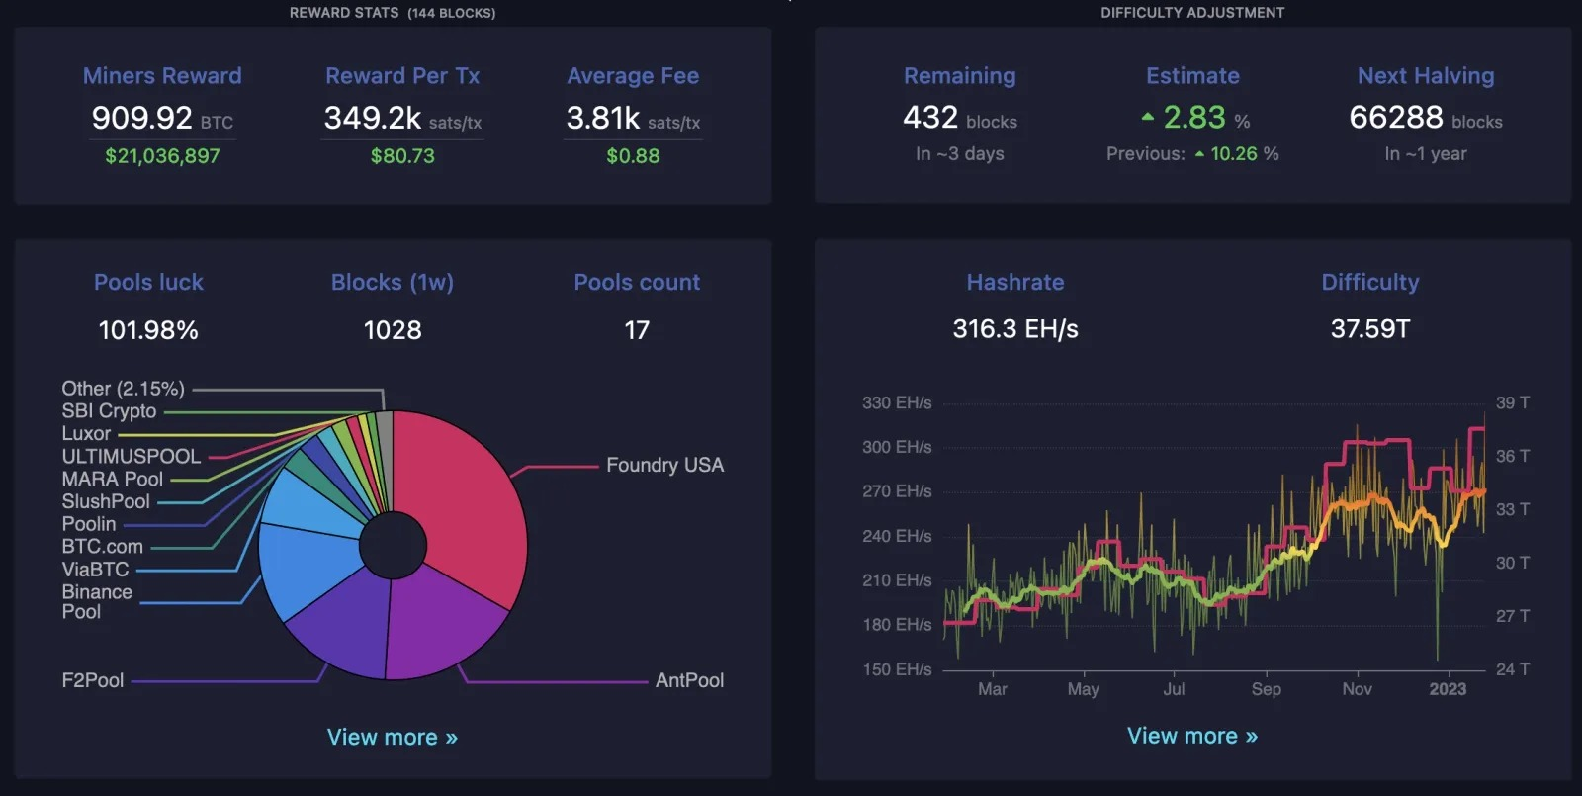
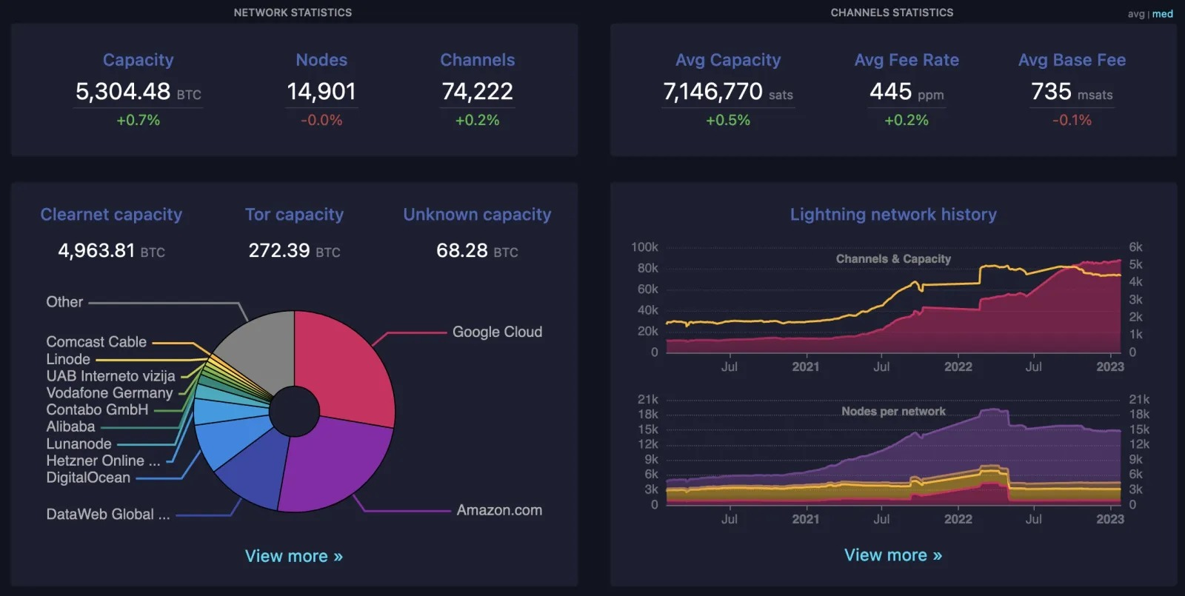
Tip of the week: mempool.space
Bitcoin stats:
Lightning stats:

Slide 7
Breakout: Assignment presentations

Slide 8
Reflection in the main room

Slide 9
Why putting in effort and make great slides?
0- for your own learning!
1- possibility to get featured on Bitcoin Talents social media (LinkedIn, Twitter)
2- possibility to get exposure and feedback during the session by presenting your findings
3- publish your slides after the sessions on your own social media - great for feedback!
4- you can become a mentor for the next batch
5- possibility to be invited and featured in webinars
6- Opportunity to receive special "supertalent" certificate
You can use the Content Questionnaire to submit content (not assignments), e.g., articles, studies, projects relevant to Bitcoin (needs to have relevant Bitcoin insights/content)

Slide 10
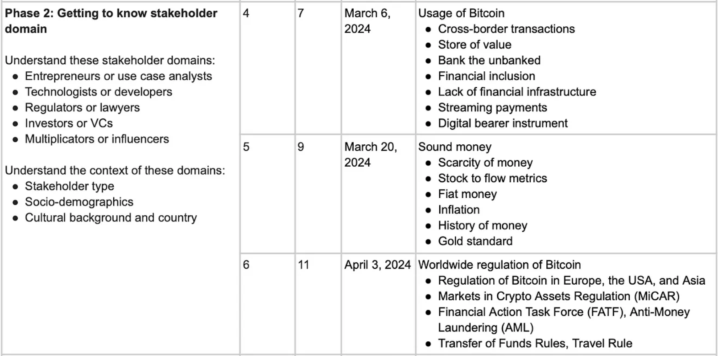
Outlook on the next session

Slide 11
Assignment 3
DYOR!
Bitcoin use cases: For each use case, explain the added value of Bitcoin technology compared to existing solutions.
Payments, e.g.,
Cross-border transactions
Streaming payments
Privacy-focused transactions
etc.
Store of value
Financial inclusion (“banking the unbanked”)
Digital bearer instrument
Ordinals NFTs
What’s the future of Bitcoin?
Try to briefly sketch the future of Bitcoin and its use cases.
Identify at least 3 challenges that still need to be addressed for Bitcoin to reach its full potential.
Reminder: Create a Profile Slide for yourself in order to be listed as a Talent on our Bitcoin Talents website (see https://web3-talents.io/dlt-talents/dlt-talents-profiles/) - Deadline: Friday, February 23, 2024 (12:00 PM [CET/CEST])

Slide 12
Assignment XYZ
Add your text, images, screenshots, slides etc. here
Use this slide and add your content, text, image, screenshots etc. here. To do so, make a copy of this file for your own slides: Click on “File”, “Make a copy”, save the URL, then edit slides. Create more assignment slides when needed and change layout/design if desired.
Try to present your key learnings in less than 3 min.

Slide 13
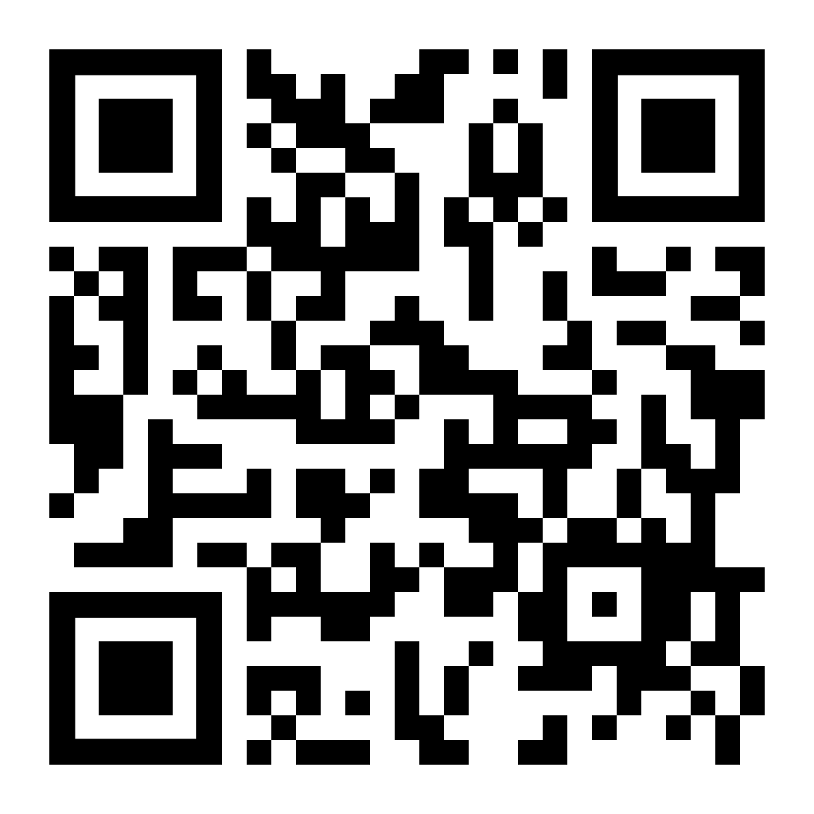
Submit Assignment
https://forms.gle/iRNjCf8TCHi8My7v5
You can use the Content Questionnaire to submit content, e.g., articles, studies, projects relevant to Bitcoin (needs to have relevant Bitcoin insights/content)

Slide 14
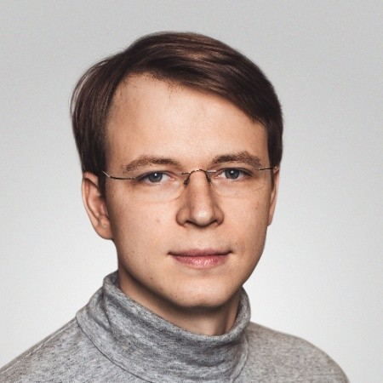


Guest Speaker: Ilya Evdokimov
Founder of SatsBridge

Slide 15
Next: Session 4
ORGANIZED BY
Follow us on
March 6, 2024
Supported by

